Slide 1
Product Changeover (Wet Side)
7.25.24 version 2.0

Slide 2
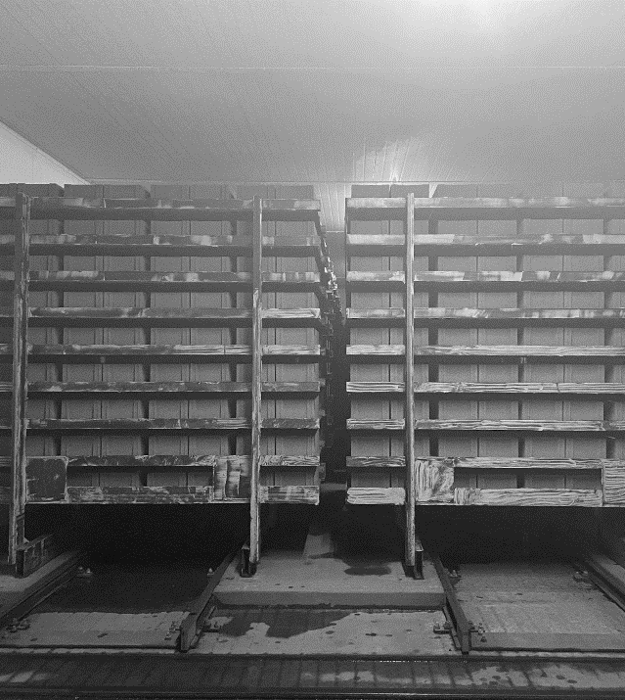
Assumptions and Prerequisite Skills
The unloading bay has current unloading product stuck behind loading product
Requires strong knowledge of how the Bessermatic works, as well as the curing process of racks regarding loading and unloading from the car
Supplies Needed
Standard PPE

Slide 3
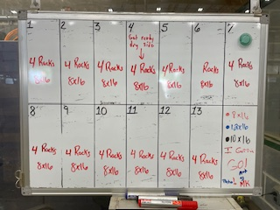
1. Outside the control room, there is a chart indicating what product is in each bay. If a bay has a combination of two or more different products (ex: “2 racks 8x16, 2 racks 10x16”), there is a chance the unloading product is stuck behind the loading product.
Figure 1

Slide 4
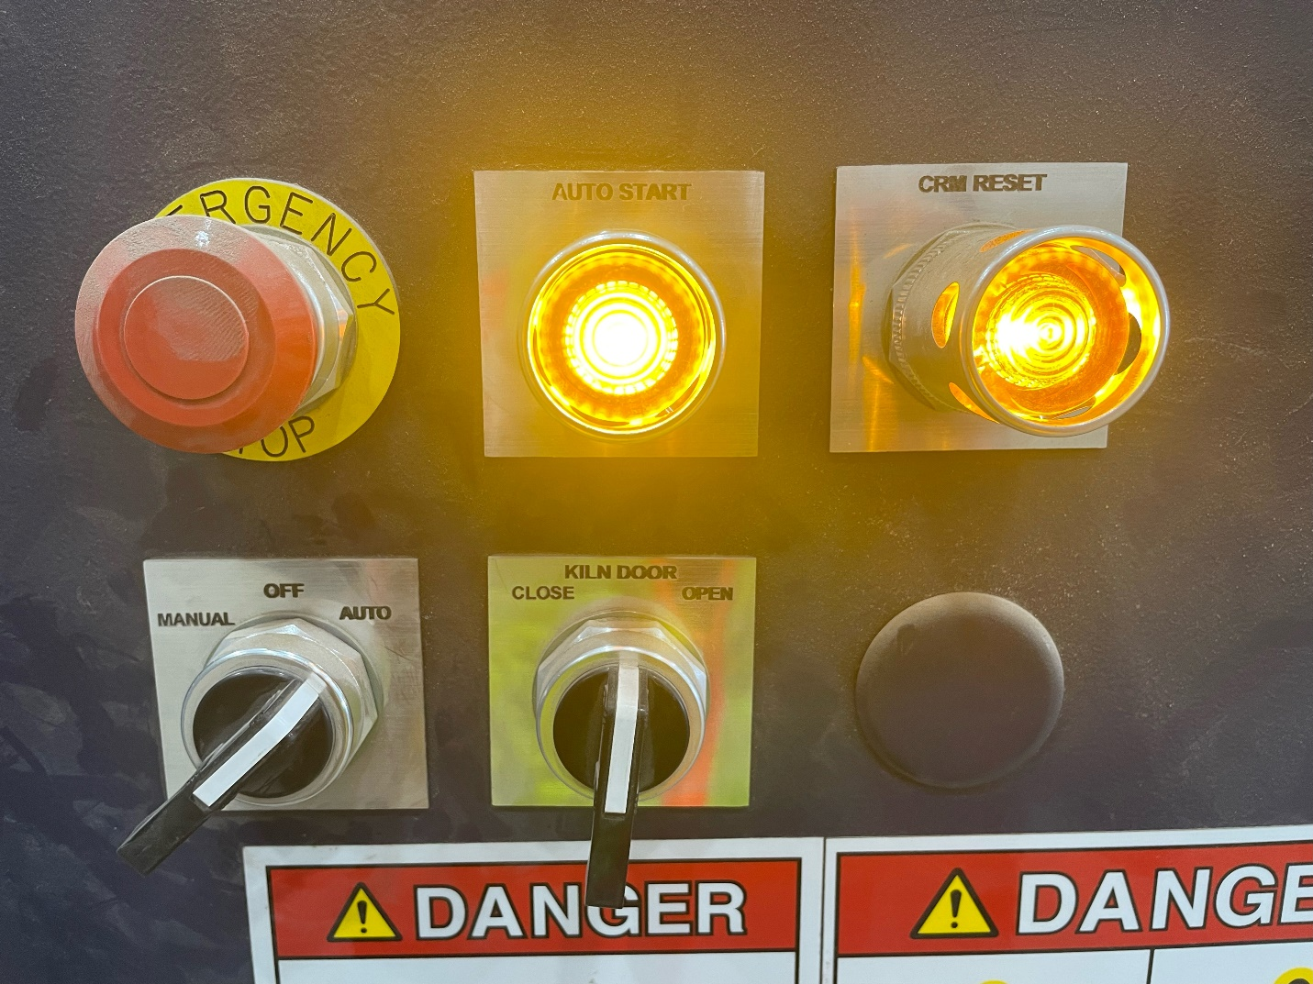
2. Before the car goes to that bay, proceed to the control panel next to the kiln door. Flip the control switch to the “manual” position.
3. Turn and hold the “Kiln Door” switch to the “open” position until the door is no longer moving. Be mindful to slow the door down when nearing the back-stop to prevent slamming.
Figure 2

Slide 5
4. Go to the bay with the mixed products and assess how many racks have the unloading product. Keep in mind that there may be a rack that has both loading and unloading product. This needs to be taken into consideration.

Slide 6
Possible Scenarios
1
5
2
6
3
7
4
Loading Product
Unloading Product
Mixed Rack (some loading some unloading)

Slide 7
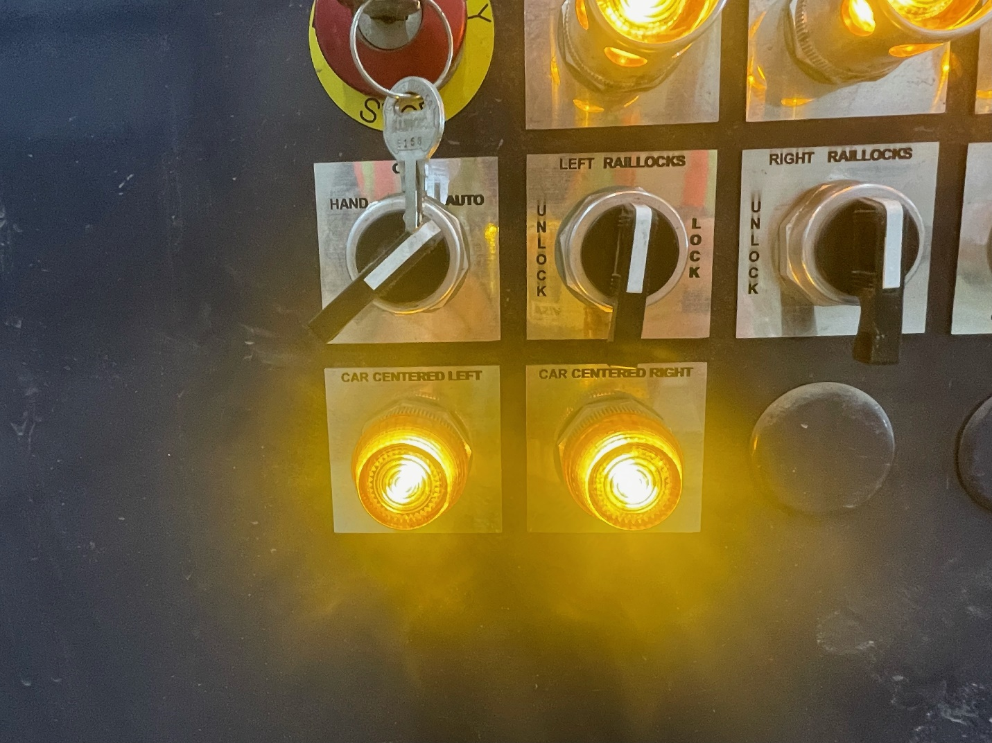
Scenario #1 & #2
Unloading Bay
Rack 1
Mixed
Rack 2
Loading
Rack 3
Loading
Rack 4
Loading
1.1. Wait until the crawler has loaded rack 4 onto the new loading bay and has just retrieved its unloading rack. Flip the car control switch to the “Hand” position (Green circle in Figure 1.2).
Loading Bay
Rack 1
Loading
Figure 1.1
Figure 1.2

Slide 8
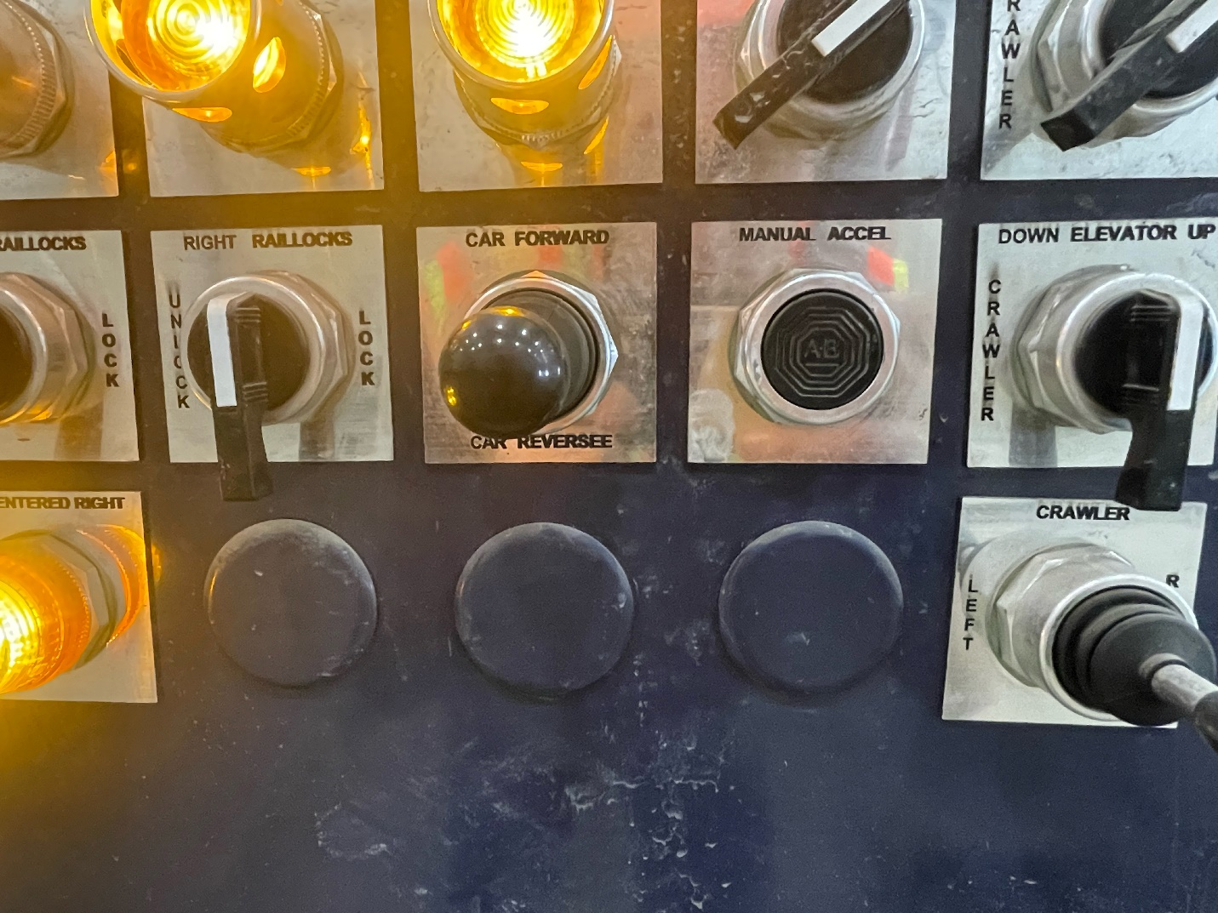
Scenario #1 & #2
1.2. Use the lever on the second row to move the car to the “reverse” position (Red circle in Figure 1.3). You can press the “Manual Accel” button to speed the car up (Pink circle in Figure 1.3).
Figure 1.3

Slide 9
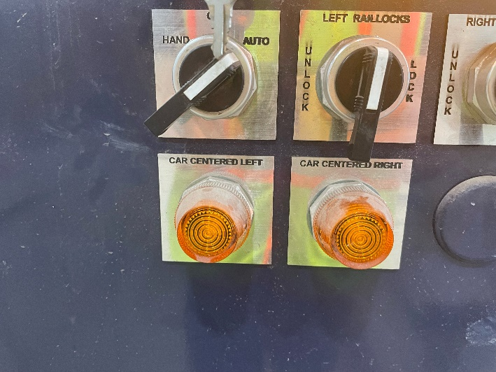
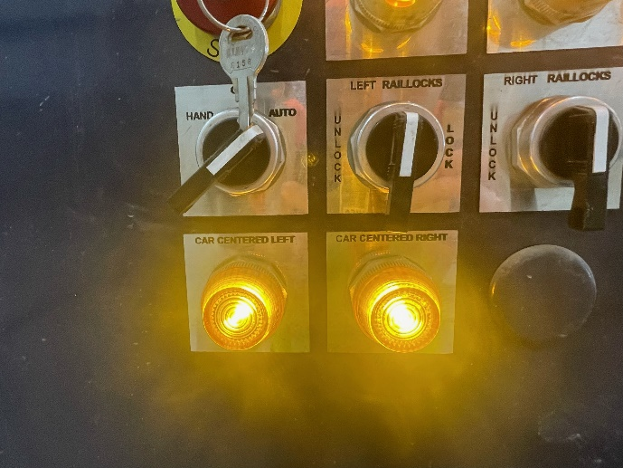
Scenario #1 & #2
1.3. hold the “Reverse” lever from step 1.2 until the “Car Centered Left” button lights up (Figure 1.4).
Figure 1.4 : off
Figure 1.4: on

Slide 10
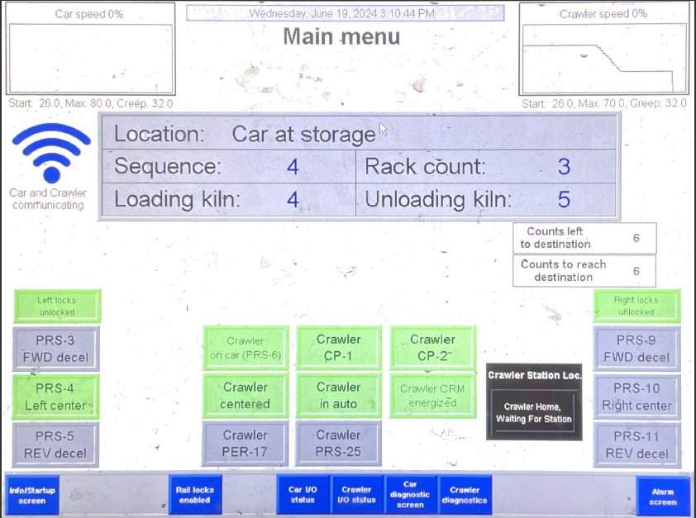
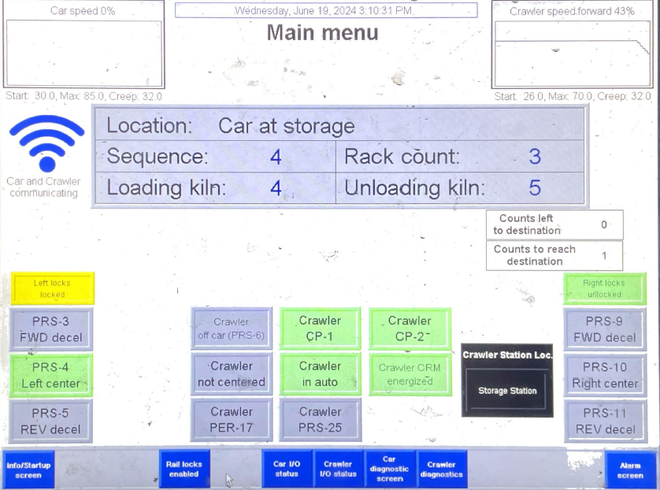
Scenario #1 & #2
Figure 1.5
1.4. Flip the “Left Raillocks” switch to the “Lock” position (Purple arrow in Figure 1.5) and hold it at that position until you see the “Left Locks Locked” box (Figure 1.6).
Figure 1.6. unlocked
Figure 1.6: locked

Slide 11
Scenario #1 & #2
Unloading Bay
Rack 1
Mixed
Rack 2
Loading
Rack 3
Loading
Loading Bay
Rack 1
Loading
Rack 4
Loading
1.5. Figure 1.7 is what the loading bay should now look like.
Car
Figure 1.7

Slide 12
Scenario #1 & #2
1.6. Once the crawler comes back to the car, unlock the raillocks (Purple circle in Figure 1.8), and move the car forward back to the unloading bay. Lock the left raillocks again, making the crawler unload the next rack.
Figure 1.8

Slide 13
Scenario #1 & #2
Unloading Bay
Rack 1
Mixed
Loading Bay
1.7. Repeat 1.1-1.6 until the Loading and Unloading bay looks like Figure 1.9. You now have access to the mixed rack.
Rack 1
Loading
Rack 4
Loading
Rack 3
Loading
Rack 2
Loading
Car
Figure 1.9

Slide 14
Scenario #1 & #2
1.8. Move the car forward once more collecting the rack with the mixed product. Lock the left raillocks.

Slide 15
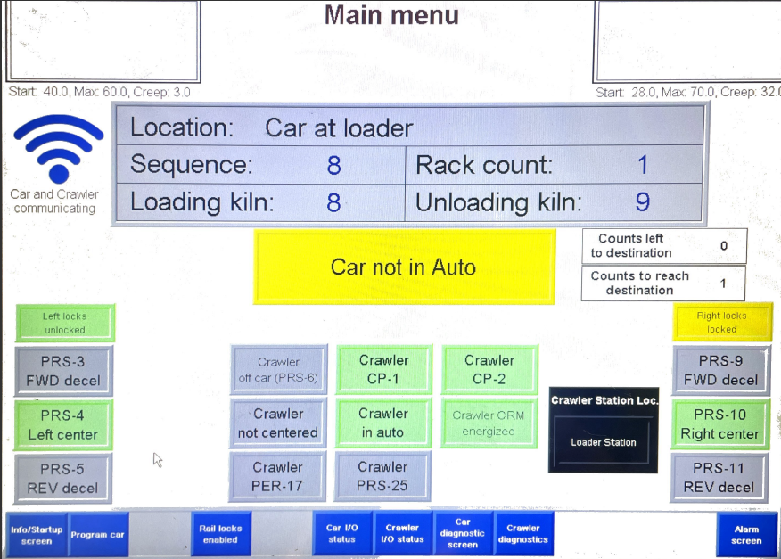
Scenario #1 & #2
1.9. While the crawler is collecting the final rack, go to the “Program Car” page (Red circle in Figure 1.10).
Figure 1.10

Slide 16
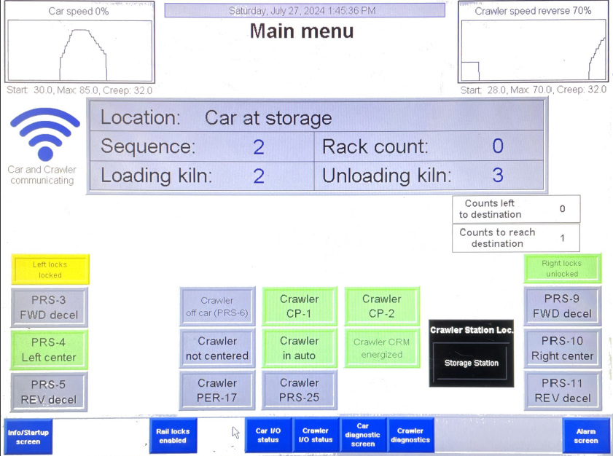
Scenario #1 & #2
1.10. Press on the blue box to the right of the “Location” label until the box says “Car at Storage” (Yellow circle in Figure 1.11). “Car at Storage” indicates that the car is unloading a rack from a bay to be transferred to the unloading side of the Bessermatic.
Figure 1.11

Slide 17
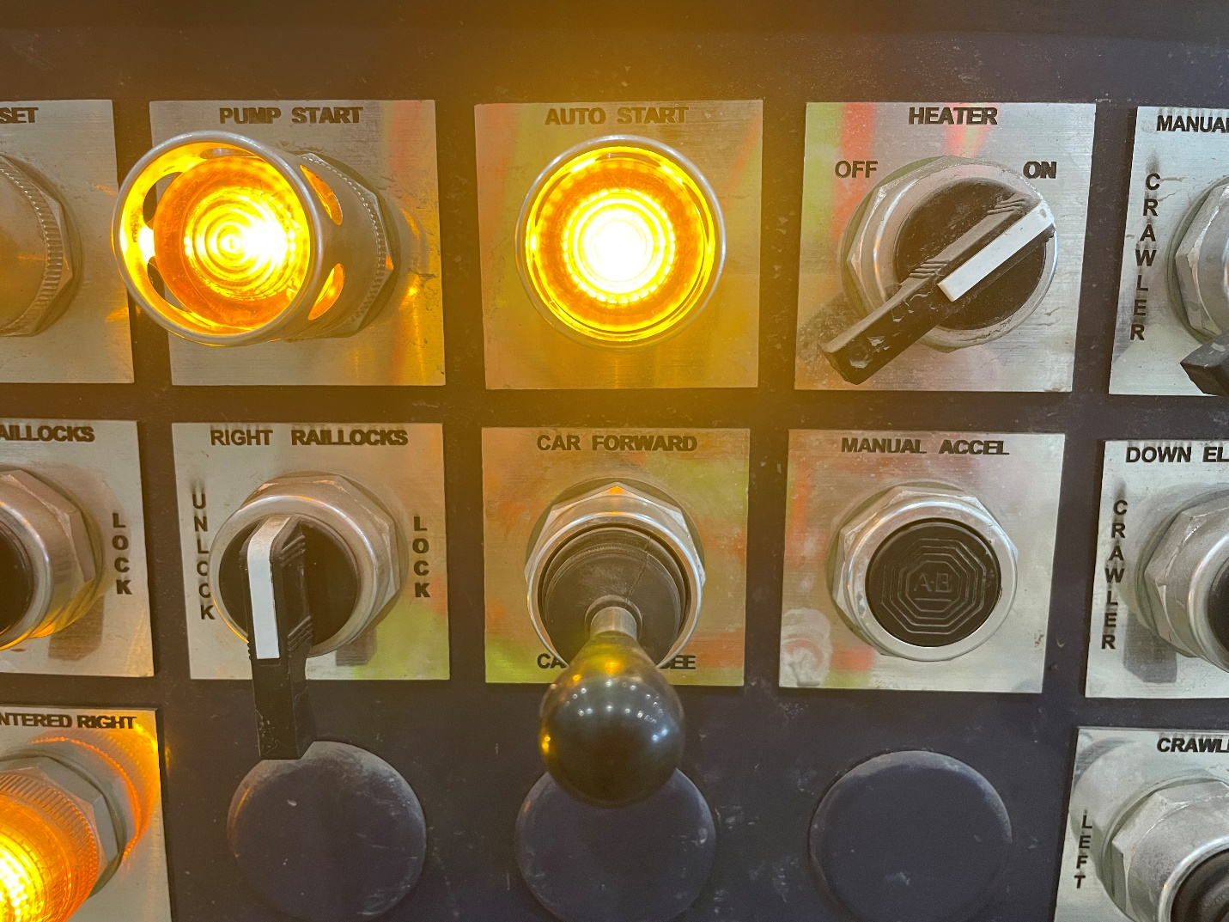
Scenario #1 & #2
1.11. Flip the Control switch back to the “Auto” position. Hit the “Pump Auto Start” button (Purple circle in Figure 1.12).
Figure 1.12

Slide 18
Scenario #1 & #2
1.11. Go to the kiln door control panel. Flip the control switch to “Auto” and press the “Auto Start” button (Red circle in Figure 1.13).
Figure 1.13

Slide 19
Scenario #3
Unloading Bay
Rack 1
Unloading
Rack 2
Mixed
Rack 3
Loading
Rack 4
Loading
3.1. Wait until the crawler has loaded its first rack onto the new loading bay and has just retrieved its unloading rack (Figure 3.1). Flip the car control switch to the “Hand” position (Green circle in Figure 3.2).
Loading Bay
Car
Rack 1
Loading
Figure 3.1
Figure 3.2

Slide 20
Scenario #3
3.2. Use the lever on the second row to move the car to the “reverse” position (Red circle in Figure 3.3). You can press the “Manual Accel” button (Pink circle in Figure 3.3) to speed the car up.
Figure 3.3

Slide 21
Scenario #3
3.3. hold the “Reverse” lever from step 3.2 until the “Car Centered Left” button lights up (Figure 3.4).
Figure 3.4: off
Figure 3.4: on

Slide 22
Scenario #3
3.4. Flip the “Left Raillocks” switch to the “Lock” position (purple arrow in Figure 3.5) and hold it at that position until you see the “Left Locks Locked” box (red circles in Figure 3.6).
Figure 3.5
Figure 3.6: Unlocked
Figure 3.6: Locked

Slide 23
Scenario #3
Unloading Bay
Rack 1
Unloading
Rack 2
Mixed
Rack 3
Loading
Loading Bay
3.5. Figure 3.7 is what the loading bay should now look like.
Rack 1
Loading
Rack 4
Loading
Car
Figure 3.7

Slide 24
Scenario #3
3.6. Once the crawler comes back to the car, unlock the raillocks (purple circle in Figure 3.8), and move the car forward back to the unloading bay. Lock the left raillocks again, making the crawler unload the next rack.
Figure 3.8

Slide 25
Scenario #3
Unloading Bay
Rack 1
Unloading
Rack 2
Mixed
Loading Bay
3.7. Repeat 3.1-3.6 until the Loading and Unloading bay looks like Figure 3.9.
Rack 1
Loading
Rack 4
Loading
Rack 3
Loading
Car
Figure 3.9

Slide 26
Scenario #3
Unloading Bay
Rack 1
Unloading
Rack 2
Mixed
Car
Loading Bay
3.8. Move the car forward once more collecting the rack with the mixed product. Lock the left raillocks.
Rack 1
Loading
Rack 4
Loading
Rack 3
Loading
Figure 3.10

Slide 27
Scenario #3
Kiln Room
Bessermatic (Loading)
Bessermatic (Unloading)
3.9. Once the crawler collects this rack and safely returns to the car, move the car out of the kiln room to the auxiliary railway (Red circle in Figure 3.11).
Unloader
Figure 3.11
Loader
Auxiliary

Slide 28
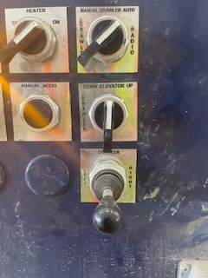
Scenario #3
3.10. Before you unlock the rail, flip the “Manual Crawler Auto” switch to the “Crawler” position (red circle in Figure 3.12).
Figure 3.12

Slide 29
Scenario #3
3.11. Instead of locking the left raillocks, you would want to lock the right raillocks this time (Purple arrow in Figure 3.13).
Figure 3.13

Slide 30
Scenario #3
3.12. At this time, move and hold the “Crawler” lever to the “Right” position (Red circle in Figure 3.14) until the entire rack is on the storage railway.
Figure 3.14

Slide 31
Scenario #3
3.13. Move and hold the “Crawler Elevator” lever to the “Down” position (Red circle in Figure 3.15) until the rack is independently sitting on the rail.
Figure 3.15

Slide 32
Scenario #3
3.14. Move the crawler back into the car. Hold the lever until you see the “Crawler on Car” label light up (Red circles in Figure 3.16).
Figure 3.16: Crawler Off Car
Figure 3.16: Crawler On Car

Slide 33
Scenario #3
Unloading Bay
Rack 1
Unloading
3.15. Move the car back into the kiln room to pick up the fully unloading rack.
Loading Bay
Car
Rack 1
Loading
Rack 4
Loading
Rack 3
Loading
Figure 3.17

Slide 34
Scenario #3
Kiln Room
Bessermatic (Loading)
Bessermatic (Unloading)
3.16. Move this rack out of the kiln room but this time, drop it off on the loading rail (Red circle in Figure 3.18). No need to manually move the crawler this time.
New Loading Rack
Unloader
Car
Loader
Rack 1
Unloading
Figure 3.18
Rack 2
Mixed
Auxiliary

Slide 35
Scenario #3
Kiln Room
Bessermatic (Loading)
Bessermatic (Unloading)
3.17. To reduce down-time, collect the loading product and put it in the same bay where all the other loading products have been placed.
New Loading Rack
Unloader
Car
Loader
Figure 3.19
Rack 2
Mixed
Auxiliary

Slide 36
Scenario #3
Kiln Room
Bessermatic (Loading)
Bessermatic (Unloading)
3.18. Once that rack has been dropped off, move the car out of the kiln room, pick up the mixed rack from the auxillary rail, and place it on the Unloading rail.
Unloader
Loader
Rack 2
Mixed
Figure 3.20
Car
Auxiliary

Slide 37
Scenario #3
3.19. While the crawler is dropping off the final rack, go to the “Program Car” page (Red circle in Figure 3.21).
Figure 3.21

Slide 38
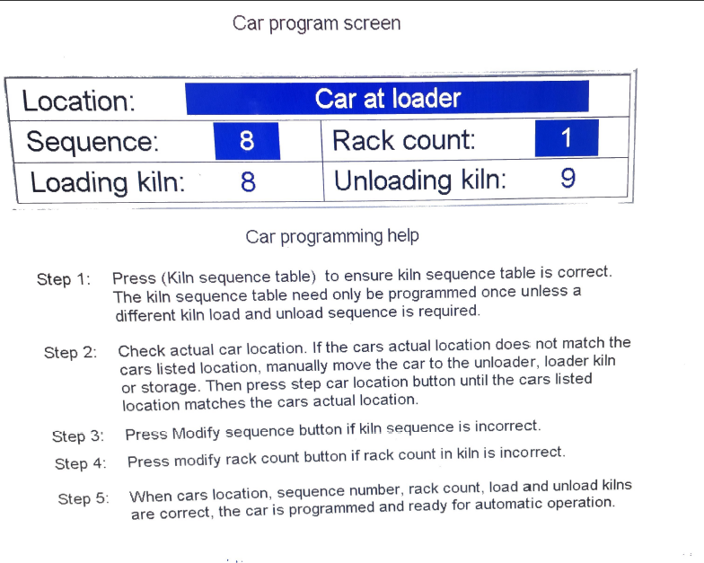
Scenario #3
3.20. Press on the blue box to the right of the “Location” label until the box says, “Car at Loader” (Yellow circle in Figure 3.22).
Figure 3.22

Slide 39
Scenario #3
3.21. Flip the control switch back to “Auto” and press the “Auto Pump Start” button (Purple circle in Figure 3.23).
Figure 3.23

Slide 40
Scenario #4
Unloading Bay
Rack 1
Unloading
Rack 2
Unloading
Rack 3
Loading
Rack 4
Loading
Loading Bay
4.1. Wait until the crawler has loaded its first rack onto the new loading bay and has just retrieved its unloading rack. Flip the car control switch to the “Hand” position (Green circle in Figure 4.2).
Rack 1
Loading
Figure 4.1
Figure 4.2

Slide 41
Scenario #4
4.2. Use the lever on the second row to move the car to the “reverse” position (Red circle in Figure 4.3). You can press the “Manual Accel” button to speed the car up (Pink circle in Figure 4.3).
Figure 4.3

Slide 42
Scenario #4
4.3. hold the “Reverse” lever from step 1.2 until the “Car Centered Left” button lights up (Figure 4.4).
Figure 4.4: off
Figure 4.4: on

Slide 43
Scenario #4
Figure 4.5
4.4. Flip the “Left Raillocks” switch to the “Lock” position (Purple arrow in Figure 4.5) and hold it at that position until you see the “Left Locks Locked” box (Red circles in Figure 4.6).
Figure 4.6: Crawler On Car
Figure 4. 6: Crawler Off Car

Slide 44
Scenario #4
Unloading Bay
Rack 1
Unloading
Rack 2
Unloading
Rack 3
Loading
Loading Bay
4.5. Figure 4.7 is what the loading bay should now look like.
Rack 1
Loading
Rack 4
Loading
Figure 4.7

Slide 45
Scenario #4
4.6. Once the crawler comes back to the car, unlock the raillocks (Purple arrow in Figure 4.8), and move the car forward back to the unloading bay. Lock the left raillocks again, making the crawler unload the next rack.
Figure 4.8

Slide 46
Scenario #4
Unloading Bay
Rack 1
Unloading
Rack 2
Unloading
Loading Bay
4.7. Repeat 4.1-4.6 until the Loading and Unloading bay looks like Figure 4.9.
Rack 1
Loading
Rack 3
Loading
Rack 4
Loading
Figure 4.9

Slide 47
Scenario #4
Unloading Bay
Rack 1
Unloading
Rack 2
Unloading
Loading Bay
4.8. Move the car forward once more collecting the rack with the mixed product. Lock the left raillocks.
Rack 1
Loading
Rack 3
Loading
Rack 4
Loading
Figure 4.10

Slide 48
Scenario #3
4.9. While the crawler is dropping off the final rack, go to the “Program Car” page (Red circle in Figure 4.11).
Figure 4.11

Slide 49
Scenario #3
4.10. Press on the blue box to the right of the “Location” label until the box says, “Car at Loader” (Yellow circle in Figure 4.12).
Figure 4.12

Slide 50
Scenario #4
4.11. Flip the Control switch back to the “Auto” position. Hit the “Pump Auto Start” button (Purple circle in Figure 4.13).
Figure 4.13

Slide 51
Scenario #5
Unloading Bay
Rack 1
Unloading
Rack 2
Unloading
Rack 3
Mixed
Rack 4
Loading
5.1. Wait until the crawler has loaded its first rack onto the new loading bay and has just retrieved its unloading rack. Flip the car control switch to the “Hand” position (Green circle in Figure 5.2).
Figure 5.1
Loading Bay
Rack 1
Loading
Figure 5.2

Slide 52
Scenario #5
5.2. Use the lever on the second row to move the car to the “reverse” position (Red circle in Figure 5.3). You can press the “Manual Accel” button (Pink circle in Figure 5.3) to speed the car up.
Figure 5.3

Slide 53
Scenario #5
5.3. hold the “Reverse” lever from step 1.2 until the “Car Centered Left” button lights up (Figure 5.4).
Figure 5.4: off
Figure 5.4: on

Slide 54
Scenario #5
Figure 5.5
5.4. Flip the “Left Raillocks” switch to the “Lock” position (Purple arrow in Figure 5.5) and hold it at that position until you see the “Left Locks Locked” box (Red circles in Figure 5.6).
Figure 5.6: Crawler On Car
Figure 5.6: Crawler Off Car

Slide 55
Scenario #5
Unloading Bay
Rack 1
Unloading
Rack 2
Unloading
Rack 3
Mixed
Loading Bay
5.5. Figure 5.7 is what the loading bay should now look like.
Rack 1
Loading
Rack 4
Loading
Figure 5.7

Slide 56
Scenario #5
5.6. Once the crawler comes back to the car, unlock the raillocks, and move the car forward back to the unloading bay. Lock the left raillocks again (Purple arrow in Figure 5.8), making the crawler unload the next rack.
Figure 5.8

Slide 57
Scenario #5
Kiln Room
Bessermatic (Loading)
Bessermatic (Unloading)
5.7. Once the crawler collects this rack and safely returns to the car, move the car out of the kiln room to the auxillary railway from the door (Red circle in Figure 5.9).
Unloader
Loader
Figure 5.9
Auxiliary

Slide 58
Scenario #5
5.8. Before you unlock the rail, flip the “Manual Crawler Auto” switch to the “Crawler” position (Red circle in Figure 5.10).
Figure 5.10

Slide 59
Scenario #5
5.9. Instead of locking the left raillocks, you would want to lock the right raillocks this time (Purple circle in Figure 5.11).
Please be careful in ensuring you are locking the correct side as this can result in the crawler derailing off the car.
Figure 5.11

Slide 60
Scenario #5
5.10. At this time, move and hold the “Crawler” lever to the “Right” position (Red circle in Figure 5.12) until the entire rack is on the storage railway.
Figure 5.12

Slide 61
Scenario #5
5.11. Move and hold the “Crawler Elevator” lever to the “Down” position (Red circle in Figure 5.13) until the rack is independently sitting on the rail.
Figure 5.13

Slide 62
Scenario #5
5.12. Move the crawler back into the car. Hold the lever until you see the “Crawler on Car” label light up (Red circles in Figure 5.14).
Figure 5.14: Crawler Off Car
Figure 5.14: Crawler On Car

Slide 63
Scenario #5
Unloading Bay
5.13. Move the car back into the kiln room to pick up the fully unloading racks.
Rack 1
Unloading
Rack 2
Unloading
Loading Bay
Rack 1
Loading
Rack 4
Loading
Figure 5.15

Slide 64
Scenario #5
Kiln Room
Bessermatic (Loading)
Bessermatic (Unloading)
5.14. Move this rack out of the kiln room but this time, drop it off on the loading rail. No need to manually move the crawler this time.
New Loading Rack
Unloader
Car
Loader
Rack 1
Unloading
Figure 5.16
Rack 3
Mixed
Auxiliary

Slide 65
Scenario #5
Kiln Room
Bessermatic (Loading)
Bessermatic (Unloading)
5.15. To reduce down-time, collect the loading product and put it in the same bay where all the other loading products have been placed.
New Loading Rack
Unloader
Car
Loader
Figure 5.17
Rack 3
Mixed
Auxiliary

Slide 66
Scenario #5
Kiln Room
Bessermatic (Loading)
Bessermatic (Unloading)
5.16. Once that rack has been dropped off, collect the last solid unloading product and put it on the loader rail similarly to step 5.14 (Red circle in Figure 5.18).
New Loading Rack
Unloader
Car
Loader
Rack 2
Unloading
Figure 5.18
Rack 3
Mixed
Auxiliary

Slide 67
Scenario #5
Kiln Room
Bessermatic (Loading)
Bessermatic (Unloading)
5.17. Pick up the mixed rack from the storage rail and place it on the Unloading rail.
Unloader
Figure 5.19
Loader
Rack 3
Mixed
Car
Auxiliary

Slide 68
Scenario #5
5.18. While the crawler is dropping off the final rack, go to the “Program Car” page (Red circle in Figure 5.20).
Figure 5.20

Slide 69
Scenario #6
5.19. Press on the blue box to the right of the “Location” label until the box says, “Car at Loader” (Yellow circle in Figure 5.21).
Figure 5.21

Slide 70
Scenario #5
5.20. Flip the control switch back to “Auto” and press the “Auto Pump Start” button (Purple circle in Figure 5.22).
Figure 5.22

Slide 71
Scenario #5
5.21. Go to the kiln door control panel. Flip the control switch to “Auto” and press the “Auto Start” button (Red circle in Figure 5.23).
Figure 5.23

Slide 72
Scenario #6
Unloading Bay
Rack 1
Unloading
Rack 2
Unloading
Rack 3
Unloading
Rack 4
Loading
Loading Bay
6.1. Wait until the crawler has loaded its first rack onto the new loading bay and has just retrieved its unloading rack. Flip the car control switch to the “Hand” position (Green circle in Figure 6.2).
Rack 1
Loading
Figure 6.1
Figure 6.2

Slide 73
Scenario #6
6.2. Use the lever on the second row to move the car to the “reverse” position (Red circle in Figure 6.3). You can press the “Manual Accel” button (Pink circle in Figure 6.3) to speed the car up.
Figure 6.3

Slide 74
Scenario #6
6.3. hold the “Reverse” lever from step 6.2 until the “Car Centered Left” button lights up (Figure 6.4).
Figure 6.4: off
Figure 6.4: on

Slide 75
Scenario #6
Figure 6.5
6.4. Flip the “Left Raillocks” switch to the “Lock” position (Purple arrow in Figure 6.5) and hold it at that position until you see the “Left Locks Locked” box (Red circles in Figure 6.6).
Figure 6.6: Crawler On Car
Figure 6.6: Crawler Off Car

Slide 76
Scenario #6
Unloading Bay
Rack 1
Unloading
Rack 2
Unloading
Rack 3
Unloading
Loading Bay
6.5. Figure 6.7 is what the loading bay should now look like.
Rack 1
Loading
Rack 4
Loading
Figure 6.7

Slide 77
Scenario #6
6.6. Once the crawler comes back to the car, unlock the raillocks (Purple circle in Figure 6.8), and move the car forward back to the unloading bay. Lock the left raillocks again, making the crawler unload the next rack.
Figure 6.8

Slide 78
Scenario #6
6.7. While the crawler is dropping off the final rack, go to the “Program Car” page (Red circle in Figure 6.9).
Figure 6.9

Slide 79
Scenario #6
6.8. Press on the blue box to the right of the “Location” label until the box says, “Car at Loader” (Yellow circle in Figure 6.10).
Figure 6.10

Slide 80
Scenario #6
6.9. Flip the Control switch back to the “Auto” position. Hit the “Pump Auto Start” button (Purple circle in Figure 6.11).
Figure 6.11

Slide 81
Scenario #6
6.10. Go to the kiln door control panel. Flip the control switch to “Auto” and press the “Auto Start” button (Red circle in Figure 6.12).
Figure 6.12

Slide 82
Scenario #7
Unloading Bay
Rack 1
Unloading
Rack 2
Unloading
Rack 3
Unloading
Rack 4
Mixed
7.1. Wait until the crawler has loaded its first rack onto the new loading bay and has just retrieved its unloading rack. Flip the car control switch to the “Hand” position (Green circle in Figure 7.2).
Loading Bay
Rack 1
Loading
Figure 7.1
Figure 7.2

Slide 83
Scenario #7
7.2. Use the lever on the second row to move the car to the “reverse” position (Red circle in Figure 7.3). You can press the “Manual Accel” button (Pink circle in Figure 7.3) to speed the car up.
Figure 7.3

Slide 84
Scenario #7
7.3. hold the “Reverse” lever from step 7.2 until the car is out of the kiln room and at the furthest rail from the door (Red circle in Figure 7.4). Stop moving the car when the “Car Centered Right” button lights up in this area (Figure 7.5).
Kiln Room
Figure 7.4
Bessermatic (Loading)
Bessermatic (Unloading)
Unloader
Loader
Auxiliary
Figure 7.5: off
Figure 7.5: on

Slide 85
Scenario #7
7.4. Before you unlock the rail, flip the “Manual Crawler Auto” switch to the “Crawler” position (Red circle in Figure 7.6).
Figure 7.6

Slide 86
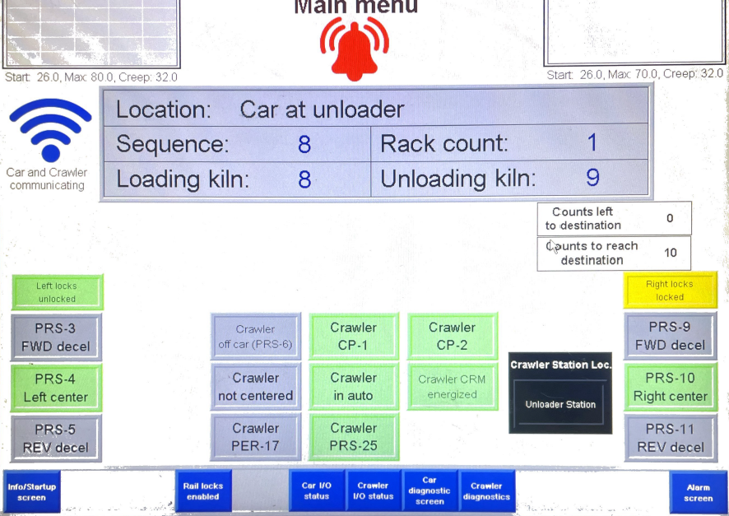
Scenario #7
7.5. Flip the “Right Raillocks” switch to the “Lock” position (Purple arrow in Figure 7.7) and hold it at that position until you see the “Right Locks Locked” box (Red circle in Figure 7.8).
Figure 7.8
Figure 7.7

Slide 87
Scenario #7
7.6. At this time, move and hold the “Crawler” lever to the “Right” position (Red circle in Figure 7.9) until the entire rack is on the storage railway.
Figure 7.9

Slide 88
Scenario #7
7.7. Move and hold the “Crawler Elevator” lever to the “Down” position (Red circle in Figure 7.10) until the rack is independently sitting on the rail.
Figure 7.10

Slide 89
Scenario #7
7.8. Move the crawler back into the car. Hold the lever until you see the “Crawler on Car” label light up (Red circles in Figure 7.11).
Figure 7.11: Crawler Off Car
Figure 7.11: Crawler On Car

Slide 90
Scenario #7
7.9. Once the crawler comes back to the car, unlock the raillocks (Purple arrow in Figure 7.12).
Figure 7.12

Slide 91
Scenario #7
Kiln Room
Bessermatic (Loading)
Bessermatic (Unloading)
7.10. Take the car to the “Loader” rail and lock the right raillocks.
New Loading Rack
Unloader
Car
Loader
Figure 7.13
Rack 4
Mixed
Auxiliary

Slide 92
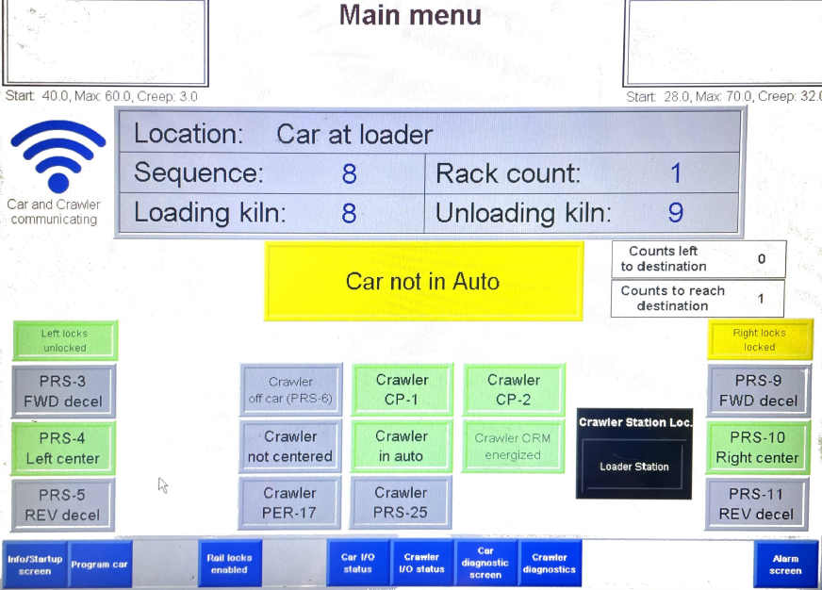
Scenario #7
7.11. While the car is collecting the loading rack, Press the “Program Car” button (Red circle in Figure 7.14).
Figure 7.14

Slide 93
Scenario #7
7.12. Press on the blue box to the right of the “Location” label until you see “Car at loader” (Yellow circle in Figure 7.15).
Figure 7.15

Slide 94
Scenario #7
7.13. Flip the control switch back to “Auto” and press the “Auto Pump Start” button (Purple circle in Figure 7.16).
Figure 7.16

Slide 95
Scenario #7
Kiln Room
Bessermatic (Loading)
Bessermatic (Unloading)
7.14. Wait until all three loading racks have been dropped off at the loader. Follow the car into the kiln room as it takes its loading rack into its proper bay.
New Loading Rack
Unloader
Car
Loader
Rack 3
Unloading
Figure 7.17
Rack 4
Mixed
Auxiliary

Slide 96
Scenario #7
Kiln Room
Bessermatic (Loading)
Bessermatic (Unloading)
7.15. Once the loading rack has been dropped off, set it back to manual, move the car back to where the mixed-product rack is, and drop it off in the unloader rail.
7.16. Repeat 7.10-7.13.
Unloader
Figure 7.18
Loader
Rack 4
Mixed
Car
Auxiliary

Slide 97
7.17. Go to the kiln door control panel. Flip the control switch to “Auto” and press the “Auto Start” button (Red button in Figure 7.19.
Figure 7.19

